Slide 1
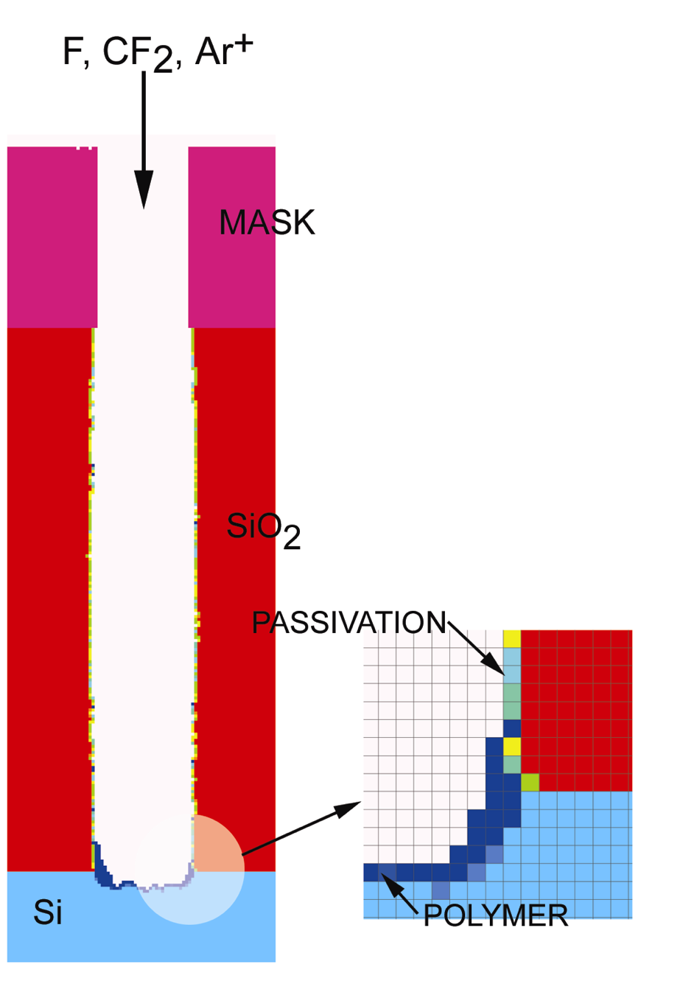
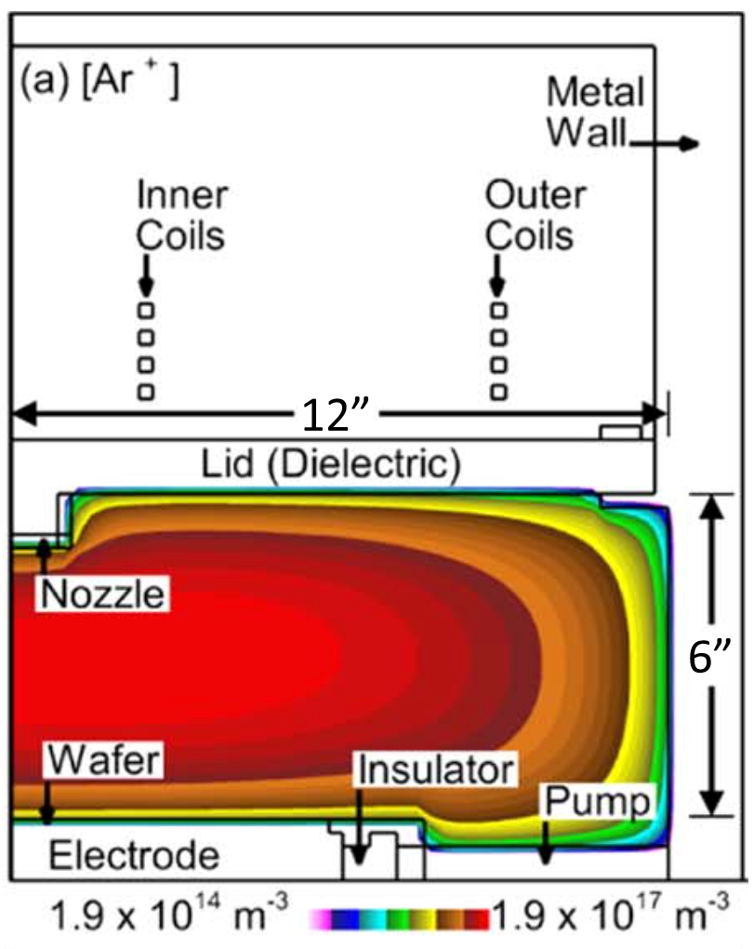
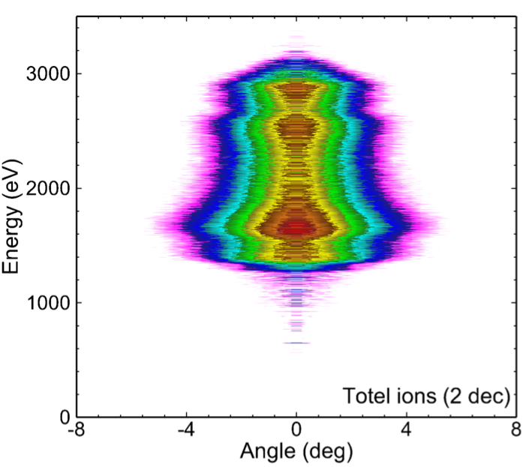
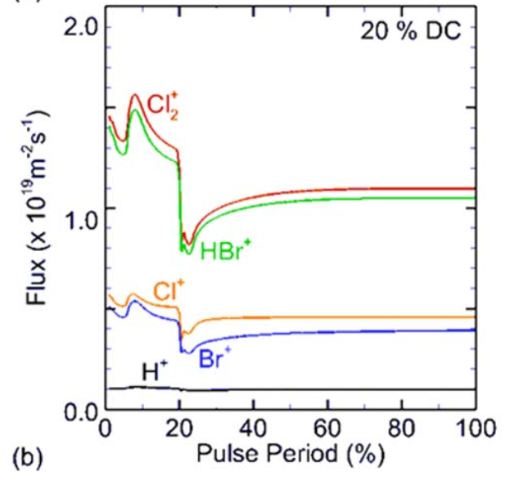
Coupled model
Reactor Scale Model
Sheath Scale Model
Feature Scale Model

Slide 2
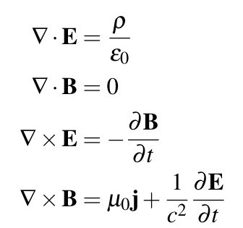
Reactor Module - solve for n, u and T
Continuity Eq.
Core fluid plasma eq.
Momentum Eq.
Energy Eq.

Slide 3
Reactor Model under electrostatic field
Continuity Eq.
Fully Coupled
To Solve simultaneously
Momentum Eq.
Poisson's Eq.
Surface Charge
Volume Charge
To solve iteratively

Slide 4
Reactor Model Diagram Flow
n_{e,} E_{s}
Energy and Chemistry Module
Fluid and Poisson Module
S_{e,} T_{e}
n_{e,} Γ_{e,} T_{e,} E_{s}
Γ_{e}
n
E_{Φ}
Surface Module
Flow Module
Magneto-static Module
J_{e,} I_{e,} σ_{e}
circuit Model
V, I

Slide 5
Feature Model Diagram Flow
No
Reflection
input:
geometry
chemistry
opteration
start a particle
move the particle
Hit Solid?
Yes
Update Geometry
Reflection or Reaction
Reaction
Update E-field

Slide 6
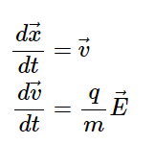
Feature Model
Pseudo-particles
Newton's Equation
Pseudo-particles, each of them representative of a large number of individual particles, are used
Surface reflection and reaction
dx
Photoresist
(x,y)
Si
SiO₂

Slide 7
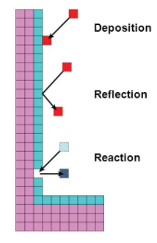
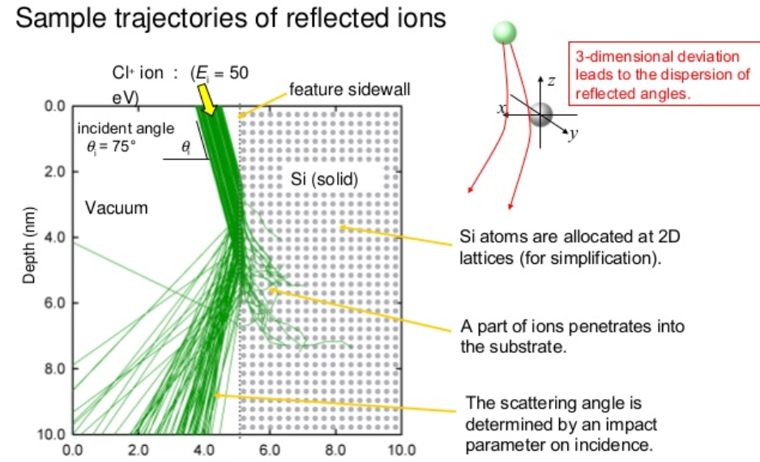
Feature Model

Slide 8
backup

Slide 9
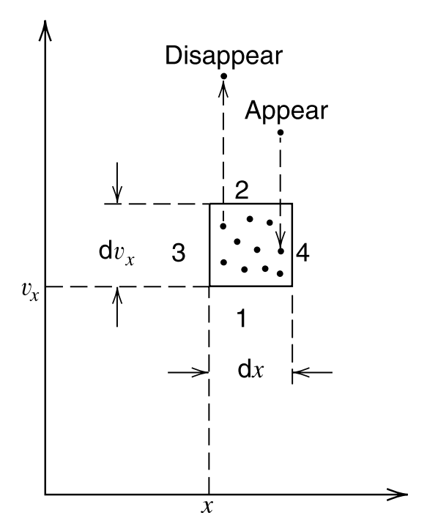
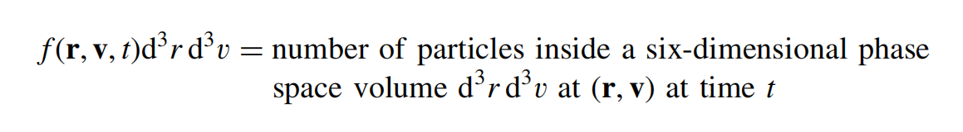
boltzmann's Equation
For a given species, we introduce a distribution function f(r, v, t) in the six dimensional phase space (r, v) of particle positions and velocities, with the interpretation that
Collisionles Boltzmann Eq. or Vlasov Eq.

Slide 10
Continuity eq. - particle conservation
Integrated within over
velocity space
both S and L are functions of n
Both n and u need to be solved.
Continuity Eq. is not sufficient.

Slide 11
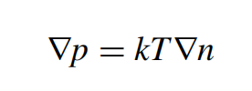
Momentum eq. - momentum conservation
Integrated within over
ignore inertial term
Ideal gas law.
Momentum Eq. contains both n and u.

Slide 12
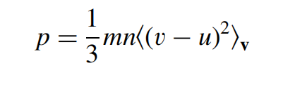
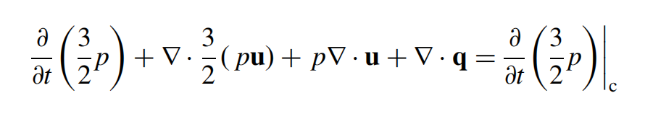
energy eq. - energy conservation
Integrated within over
ignore inertial term
Macro Energy Flux
heating or cooling due to compression or expansion
Micro Energy Flux
Energy due to collisions ro reactions
Thermal Energy
Energy Equation In Terms of Temperature.
Total Energy
Energy Flux
Power Input
Power Loss

